Slide 1
Professional Responsibility
FALL 2015

Slide 2
Today’s agenda
Introduction to the course

Slide 3
Professional Responsibility
Contact information:
Office hours:

Slide 4
What you will learn in Professional Responsibility
Technical Professionalism
◻ How to find, read, and analyze lawyer regulation
 Some basic practice management & communications skills that are key ingredients to ethical practice
Civic Professionalism
⓪①How to reconcile the values that drive lawyer regulation (formal and informal) and your own sense of yourself as a professional

Slide 5
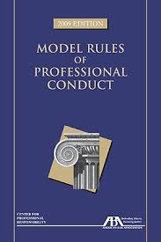
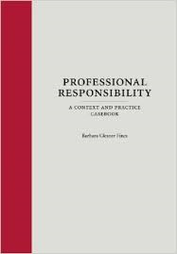
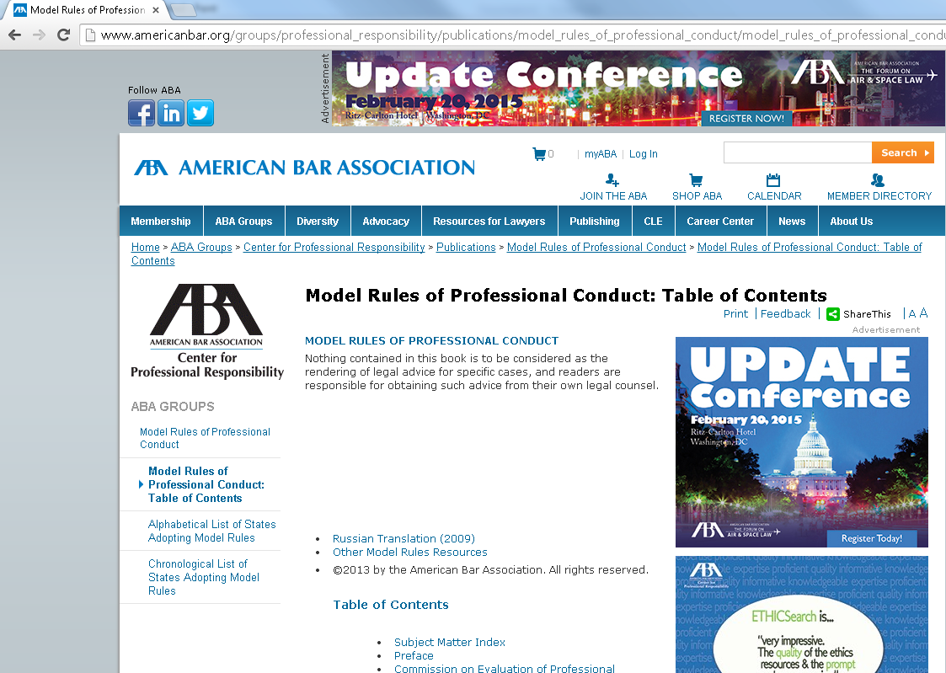
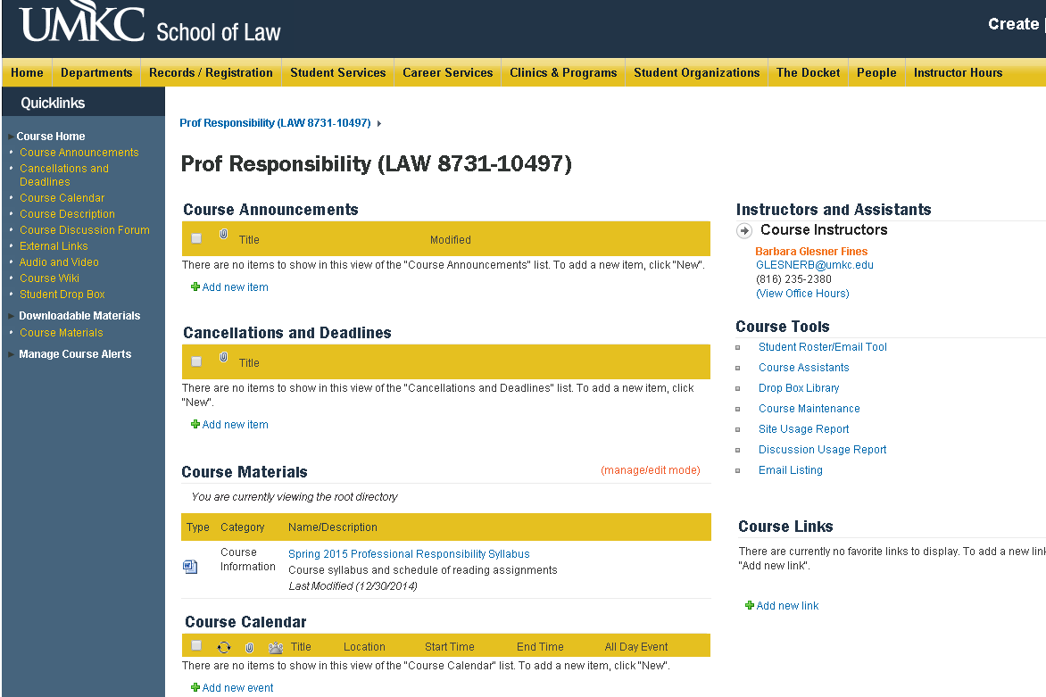
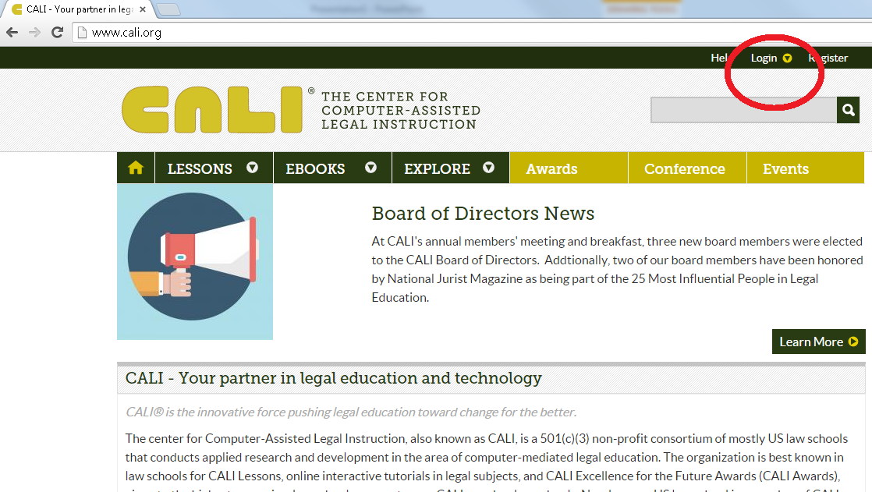
What you will need to do
Read the textbook
Read the assigned ABA Model Rules of Professional Conduct (which you can have in hard copy or can access for free online)
Be able to access web resources
Be able to access CALI lessons (our school’s authorization code is ____________)
Come to class & Actively participate

Slide 6
Grading
Your final grade will be determined based on:

Slide 7
Policies for an effective learning environment
Prepared
Prompt
Engaged
Respectful

Slide 8
Questions?

Slide 9
Chapter One What Is a Professional?

Slide 10
Goals for today’s class
Be better informed about the profession
Think about how that profession is likely to change in the future
Know that the decision about where to work and whom to represent is a pivotal ethical choice

Slide 11
The full set of PowerPoint slides is available upon adoption. Email crutan@cap-press.com for more information.

