Slide 1
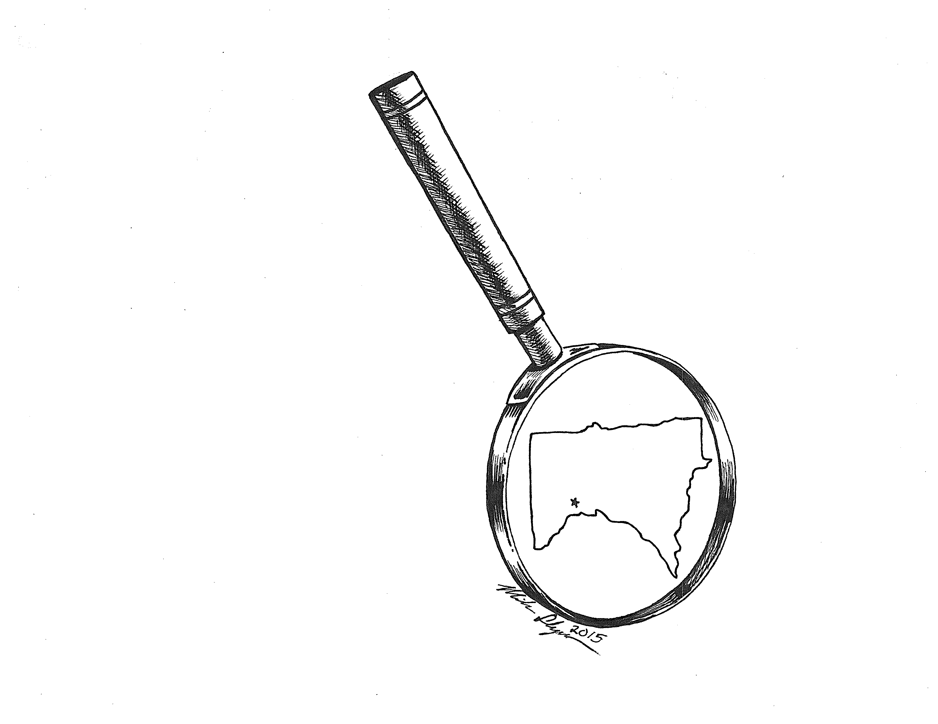
Chapter One
Powerpoint by Ellen Sackrison
Illustration by Michael C. Flynn
Not-So-Minnesota-Nice:
An Overview of Crime in Minnesota

Slide 2
Learning Objectives
Explore the criminal justice process
Define crime and understand how it is measured in Minnesota
Understand the calculation of crime rates and clearance rates
Distinguish between crime types and categories
Explore historical “true crime” cases unique to Minnesota
Examine statistical crime trends in Minnesota compared to other states
Identify Minnesota innovations in criminal justice policy and practice

Slide 3
4 Main Elements of the American Criminal Justice System
Police
Courts
Corrections
Victims’ Services
* Most criminal justice functions in the U.S. are performed at the state and local levels.

Slide 4
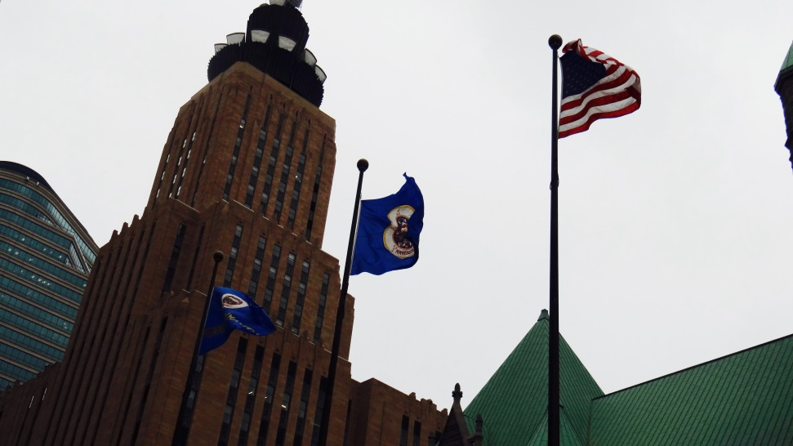
State v. Federal Systems
State and local criminal justice systems operate to arrest, prosecute, detain and serve victims within the state of Minnesota where the crime has occurred.
Violations of federal law or crimes take place across state boundaries and are handled by federal law enforcement and judicial system.
Government Center Plaza, Minneapolis MN

Slide 5
“Supreme Law of the Land”
“When there are conflicting state laws, the preemption doctrine applies, meaning the federal law overrides state law because the Constitution defines federal law as the ‘Supreme Law of the Land.’”
“Concurrent jurisdiction means an individual who violates both state and federal law can be separately charged and tried in each jurisdiction.”

Slide 6
Criminal vs. Civil Law
Criminal Law
Civil Law
Two types:
Procedural Law: How people are treated in the system.
i.e., criminal proceedings
Substantive Law: Defines what conduct is considered criminal
i.e., Fourth, fifth and six
amendments of the United
States Constitution.
Deals with the private rights between individuals or organizations.
For example:
Family court
Order for Protection
Others?

Slide 7
Justice vs. Criminal Justice
Justice
Criminal Justice
The general principle that individuals should get what they deserve
A common sense idea that has received many philosophical formulations from Aristotle to Kant
Refers to the application of the law and the administration of legal institutions
Mainly operated by trained legal professionals
* Key terms: Rule of law, procedural fairness, due process

Slide 8
Four key principles associated with rules of law
“The Government and its officials and agents as well as individuals and private entities are accountable under the law.
The laws are clear, publicized, stable and just, and applied evenly; and protect fundamental rights, including the security of persons and property.
The process by which the laws are enacted, administered, and enforced is accessible, fair, and efficient.
Justice is delivered timely by competent, ethical, and independent representatives and neutrals who are sufficient number, have adequate resources, and reflect the makeup of the communities they serve.”
(World Justice Project, 2015)

Slide 9
Figure 1.1. The Criminal Justice Process for Felony Crimes in Minnesota
Crime occurs and is reported
Police investigate
Criminal charge
Criminal complaint
Indictment
Arraignment
Omnibus Hearing
Sentencing
Trial

Slide 10
What is Crime?
Mala in se
Mala prohibita
An act that is morally wrong or “evil unto itself”
Examples:
Murder
Rape
An act that is prohibited by law
Examples:
Speeding
Underage drinking
Crime = Social Construct?

Slide 11
The full set of PowerPoint slides is available upon adoption. Email bhall@cap-press.com for more information.

