Slide 1
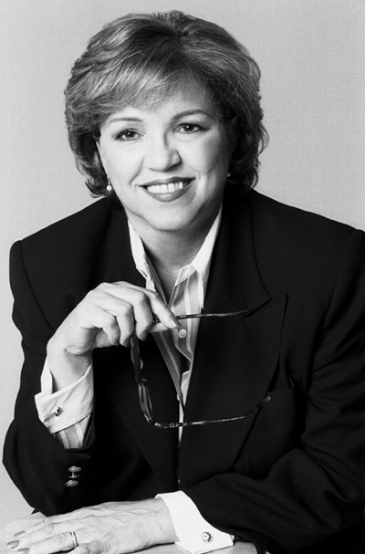
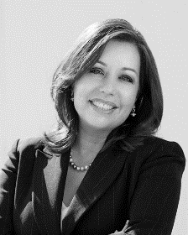
Immigration Law for Paralegals FOURTH EDITION By: Maria Isabel Casablanca & Gloria Roa Bodin
Power Point Presentation by: Gloria Roa Bodin, Esq.

Slide 2
Summary of the Immigration System
The United States Immigration classifications are divided into two major systems, i.e., temporary and permanent residence. The visas which start with one alphabetical letter, e.g., B-2, are temporary visas. The permanent residence visas are employment or relative-based.
This presentation is divided into two major visa systems:
1: Non-immigrant (NIV), which is temporary visa.
2: Immigrant Visa (IV), which grants a “Green Card” or Lawful Permanent Residence.

Slide 3
MEETING WITH THE CLIENT
Initial client contact; setting up appointment/new vs. status calls
Handling Interview
Interview/Intake Sheet/Consultation fee?
Review of entry documents, if any; EWI problems
“3/10 unlawful presence rule, bar to adjustment”
Criminal issues
Controlling talkative client: narrowing the issues
Exploring all options; visa unavailability problems
Setting the fee

Slide 4
OFFICE PROCEDURES
Retainer agreement/sequential receipts
Opening a file
Case management system: sequential file number
Color coded folders
Attaching interview sheet/ documents to file
Assigning file to paralegal/attorney
Tickler system

Slide 5
Summary of the Immigration System
USCIS Service Centers where applications are processed:
Vermont Service Center (VSC)
Texas Service Center (TSC)
California Service Center (CSC)
Nebraska Service Center (NSC)
National Benefits Center
See http://uscis.gov/graphics/index.htm

Slide 6
Temporary Visas Visitors for Business (B-1) and Pleasure (B-2)
Individuals entering the United States as visitors for business (B-1) or pleasure (B-2) enter with a temporary nonimmigrant visa.
Visa Waiver Program (VWP) is another visitor classification. The VWP program allows nationals from certain participating countries to enter the United States without applying for a B2 visa at the consulate. This program automatically grants entry at the border or port of entry for ninety days.

Slide 7
Temporary Visas Visitors for Business (B-1) and Pleasure (B-2)
The application for a B-1 and/or B-2 visa is filed with the consulate or embassy in the home country or current place of residence abroad. The process involves an interview with the consular officer, who will analyze the application and interviews the individual. If the officer suspects preconceived intent, such as intent to work or marry rather than visit, the application will be denied. Applicant must have ties to home country and adequate funds to carry out purpose of visit.

Slide 8
Temporary Visas Visitors for Business (B-1) and Pleasure (B-2)
An Applicant must complete the nonimmigrant Visa Application, DS-160. The following documents are required:
(a) passport valid at least six months beyond intended stay(s) in the U.S.;
(b) One recent photo;
(c) Proof of ties to home country, e.g., savings account, employment, tax returns, and/or real estate owned;
(d) (i) If visit is for business, a letter from the employer outlining temporary nature of business trip,
(ii) If visit is for pleasure, a letter of invitation from friend or relative in the U.S. and notarized affidavit of support, together with a U.S. tax return;
(e) Copy of round trip airline ticket; and
(f) Proof of family relationship, e.g., marriage certificate and birth certificate(s).

Slide 9
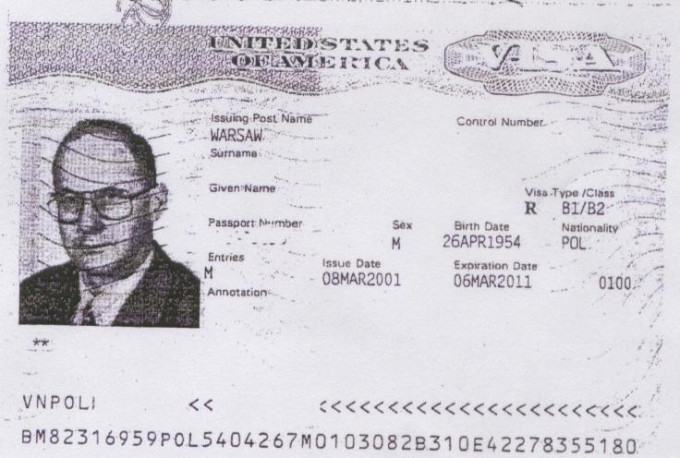
Temporary Visas Visitors for Business (B-1) and Pleasure (B-2)
Once the consular officer is satisfied with applicant’s true intent, a visa sticker will be affixed to the passport, stating, among other things, the issuance date and expiration date. Some visas are granted for as little as thirty days and others for up to ten years.
Sample of Visa Stamp

Slide 10
Temporary Visas Visitors for Business (B-1) and Pleasure (B-2)
Permissible Activities for of B-1 Visa Holders
(Visitors for Business):
Commercial transactions that do not involve gainful U.S. employment, e.g., taking orders for foreign goods;
Contract negotiation;
Installation, service, or repair of commercial/industrial equipment
Consultation with business associates;
Litigation;
Participation in scientific, educational, professional or business conventions, conferences, or seminars;
Professional entertainers involved in cultural events, paid for and sponsored by a sending country that will involve public appearance before a non-paying audience;

Slide 11
The full set of PowerPoint slides is available upon adoption. Email bhall@cap-press.com for more information.

