Slide 1
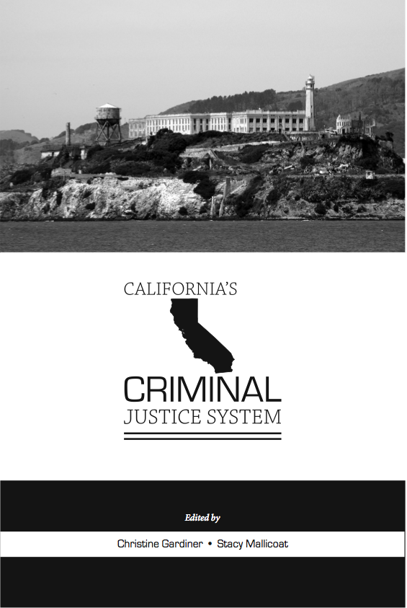
Chapter 1: Crime in California Georgia Spiropoulos

Slide 2
Outline
Overview of crime in California in 2012
Comparison of crime trends in California and nationwide for past 50 years
Comparison of 1990s crime drop in California and nationwide

Slide 3
Two Major Points
Crime in California tends to be HIGHER than national average
California crime trends parallel national crime trends

Slide 4
Uniform Crime Report (UCR)
Administered by FBI since 1929
Data collected annually from almost all law enforcement agencies in United States
Actual counts of crimes and arrests
7 Part I Index crimes
Violent: Homicide, forcible rape, robbery, aggravated assault
Property: Burglary, larceny/theft, motor vehicle theft
Arson: also tracked, but not very reliable for most agencies
Useful for comparing trends

Slide 5
UCR Limitations
Only counts Part I crimes
Only counts crimes reported to and recorded by the police
Counts are sensitive to police reporting procedures
Ex. domestic violence rule changes
Hierarchy rule dictates only the most serious crime is recorded
UCR crime definitions omit some crimes from being counted
Ex. Rape

Slide 6
Crime in CA in 2012
Note: Data taken from Crime in California, 2012, Table 1. Percentages may not add up to 100.0% due to rounding

Slide 7
Violent Crime in CA

Slide 8
Property Crime in CA

Slide 9
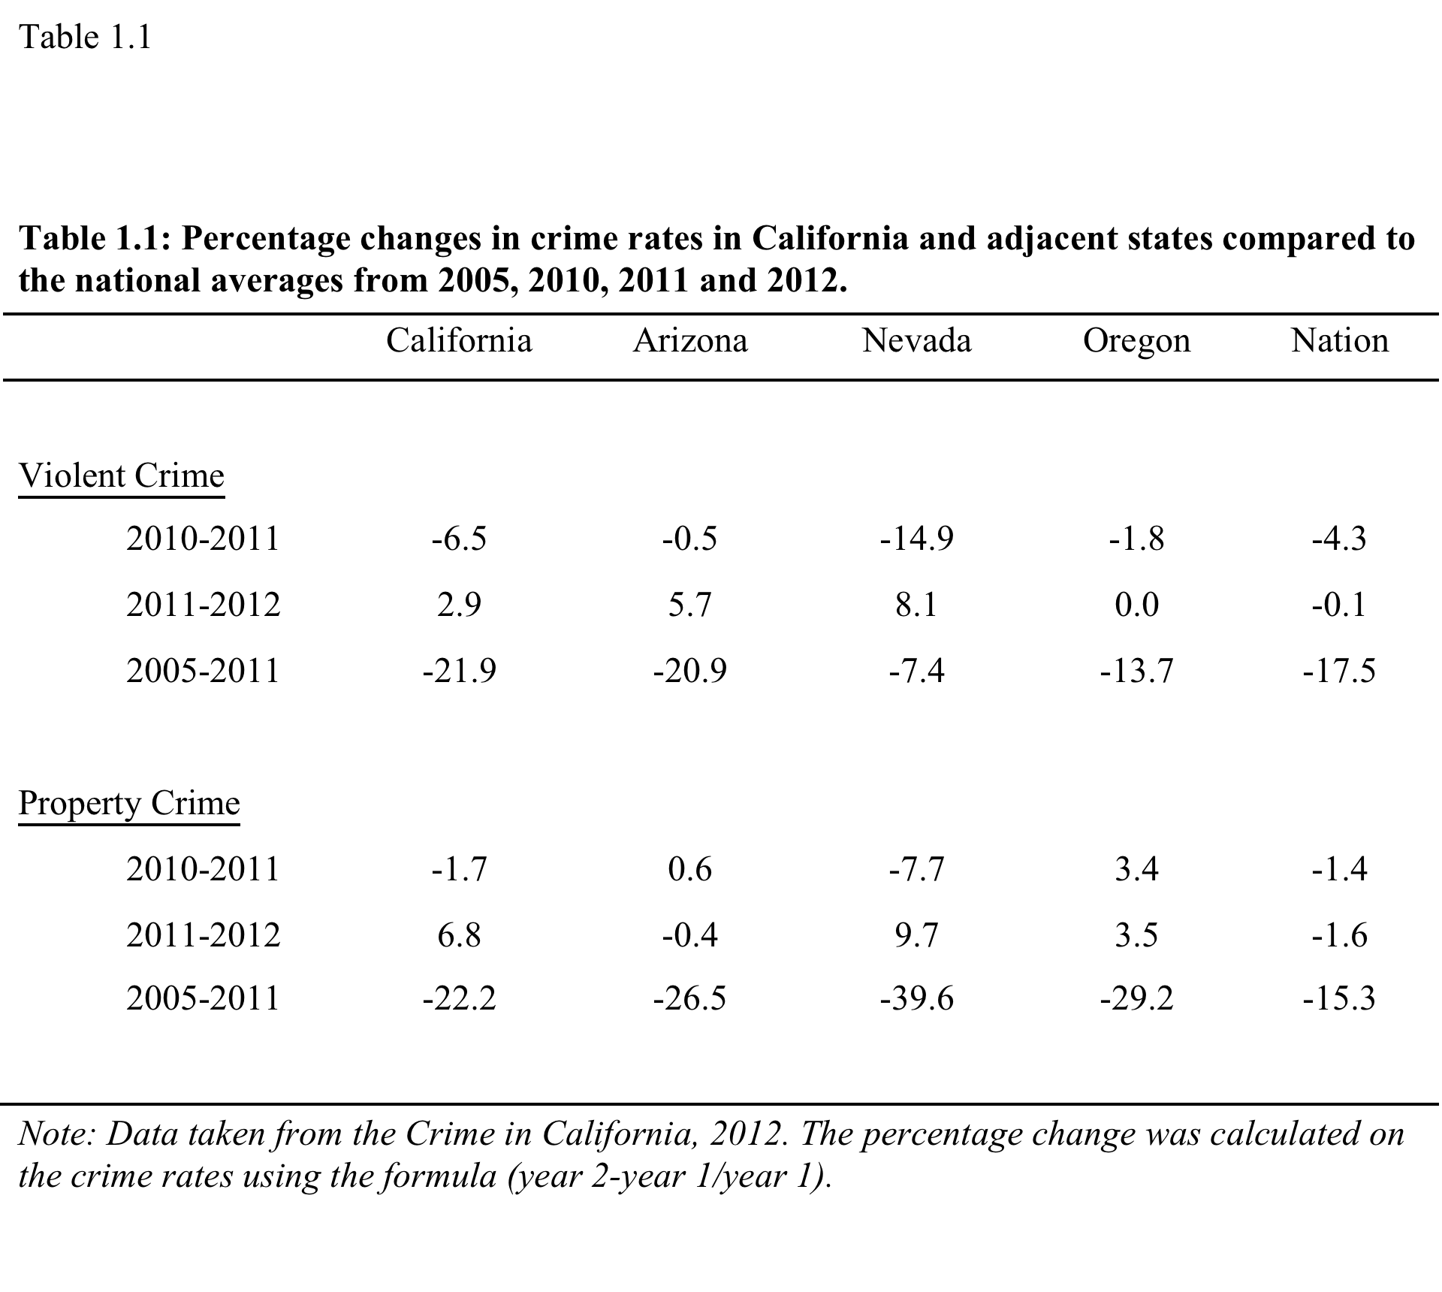

Slide 10
Murder in CA and the Nation
Source: Uniform Crime Report

Slide 11
The full set of PowerPoint slides is available upon adoption. Email bhall@cap-press.com for more information.

