Slide 1
North Carolina Fire Law
Second Edition
by C. Barrett Graham
CAROLINA ACADEMIC PRESS
PowerPoints designed by Leonard Edge
Copyright © 2010 Leonard Edge

Slide 2
Fire Protection Law
North Carolina Fire Law
Chapter One
Organization and Sources of the Law

Slide 3
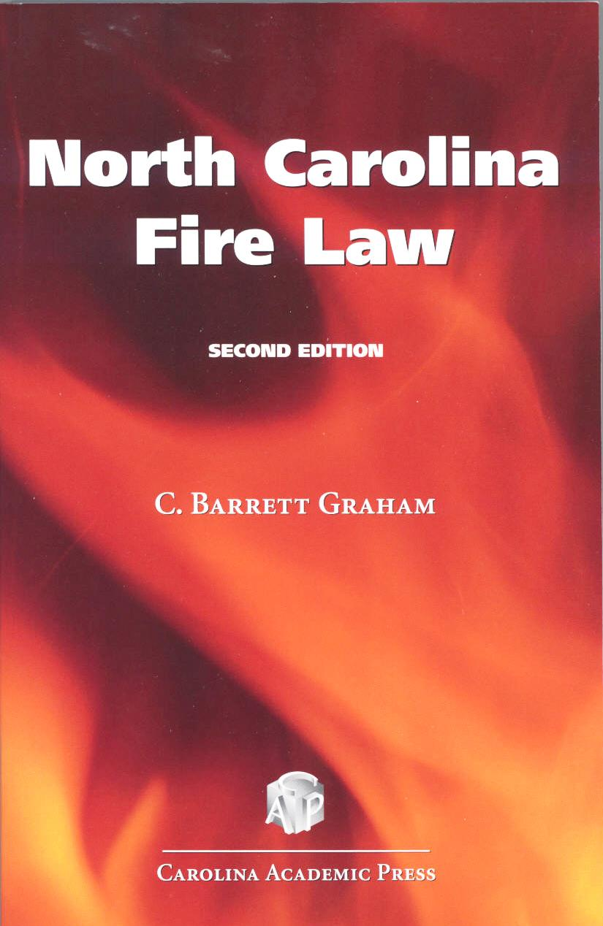
Chapter Objectives
Federal law
North Carolina law

Slide 4
To understand any legal system a student should have an overview or its physical structure and organization. This chapter will give the student an overview of the federal and North Carolina systems.
An examination of the system begins with:
The Constitution of the United States
All state and federal laws
State constitutions
Statutes
Rules
Regulations
Ordinances

Slide 5
Federal Law
Based upon the Constitution of the U.S.
The constitution consists of two parts
First part – first seven articles
Establish and empower the federal government
Second part – consists of the 27 amendments
The first 10 are know as the “Bill of Rights”
The fourteenth amendment confirms that the Constitution applies to all of us all of the time, at all levels of government.

Slide 6
The Federal Government
The first seven articles provide for the three branches of government
Executive
Enforces the law
President and the cabinet
Legislative
Creates the law
Senate and House of Representatives - Congress
Judicial
Interprets the law
Federal court system, Supreme Court of the U.S. as the top
of the system

Slide 7
Federal Government “Checks and Balances”
Examples:
A federal judge is able to declare laws unconstitutional and therefore, unenforceable. That same judge must be appointed by the president and confirmed by the Senate. Congress can remove the judge from office because of misconduct.
The president is the senior law enforcement official in the U.S. and the commander in chief of the armed forces, Congress can remove the president from office.
Member of Congress are subject to the authority of the Constitution as well. They may be removed by their peers; the laws they enact may be declared unconstitutional by the courts and therefore void or unenforceable; and as citizens, they remain subject to the authority of the executive branch of government and the judicial system.

Slide 8
United States Code
The body of federal law below the Constitution consists of the statutory laws enacted by Congress. This body of law is known as the United States Code.
Each law in the Code is designated as “title” followed by a number.
Each title, is, in turn, divided into individual statutes.
Examples;
Title Eleven – Bankruptcy Code – 11 U.S.C. 62
Title Forty Two – Civil Rights Code – 42 U.S.C. 1983

Slide 9
The full set of PowerPoint slides is available upon adoption. Email bhall@cap-press.com for more information.

