Slide 1
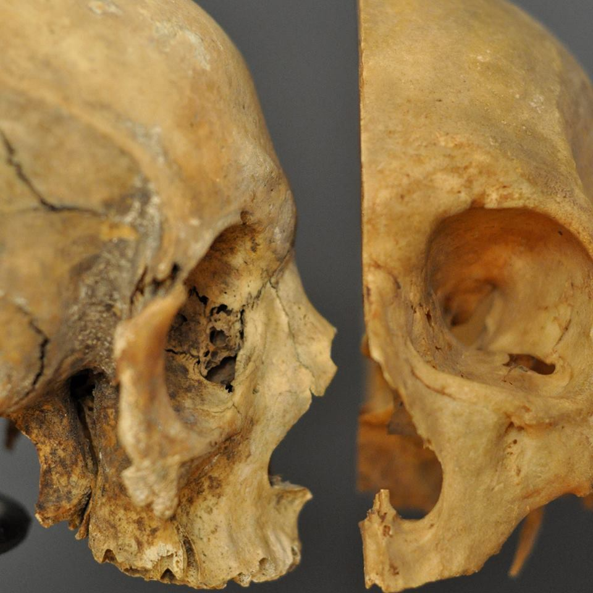
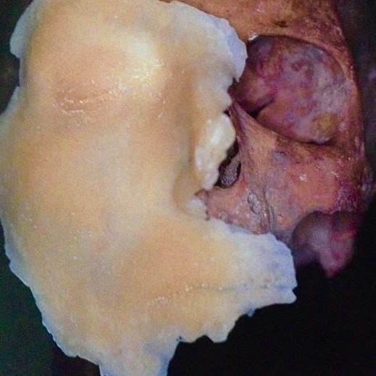
Flesh and Bone: An Introduction to Forensic Anthropology Myriam Nafte

Slide 2
Forensics
What does the term “forensic” mean?
the study of dead bodies
a legal investigation
anything at a crime scene
it’s another word for homicide

Slide 3
Forensics
The term “forensic” means
b) a legal investigation

Slide 4
Forensics
ALL legal investigations depend on the acquisition and interpretation of:

Slide 5
Forensics
What constitutes evidence?
(“Videre” is Latin: “to see”)
i) Physical ii) Testimonial

Slide 6
The full set of PowerPoint slides is available upon adoption. Email bhall@cap-press.com for more information.

