Slide 1
THE CALIFORNIA FAMILY LAW PARALEGAL
Third Edition
Dianna L. Noyes

Slide 2
Chapter One Introduction to Family Law
The Family Law Environment
Typically sole practitioner or small specialized firms
California family law is a forms-driven—Judicial Council forms
Paralegal’s Role & Responsibilities:
Often a great deal of autonomy and responsibility after gaining experience.
Front-line client contact
Assist attorney in all aspects of the case—start to finish

Slide 3
ETHICS, UPL & MALPRACTICE
California Rules of Professional Conduct (CRPC 3-310)
Unauthorized Practice of Law
Giving Legal Advice
Working directly for/with the client (B&P Code §6450)
Common Mistakes:
Statute of Limitations
Calendaring
Confidentiality
Ethical Wall

Slide 4
TYPES OF FAMILY LAW MATTERS
Dissolution
Legal Separation
Annulment
Paternity
Emancipation
Adoption
Pre and Post Marital Agreements
Domestic Partnership

Slide 5
JURISDICTION
In rem Jurisdiction
Personal jurisdiction over the individuals must be established
Domicile vs. Residence
Permanent or temporary dwelling place
Subject Matter Jurisdiction
Superior Court(s) of California
Venue
County in which one of the parties resides is where the matter may be filed

Slide 6
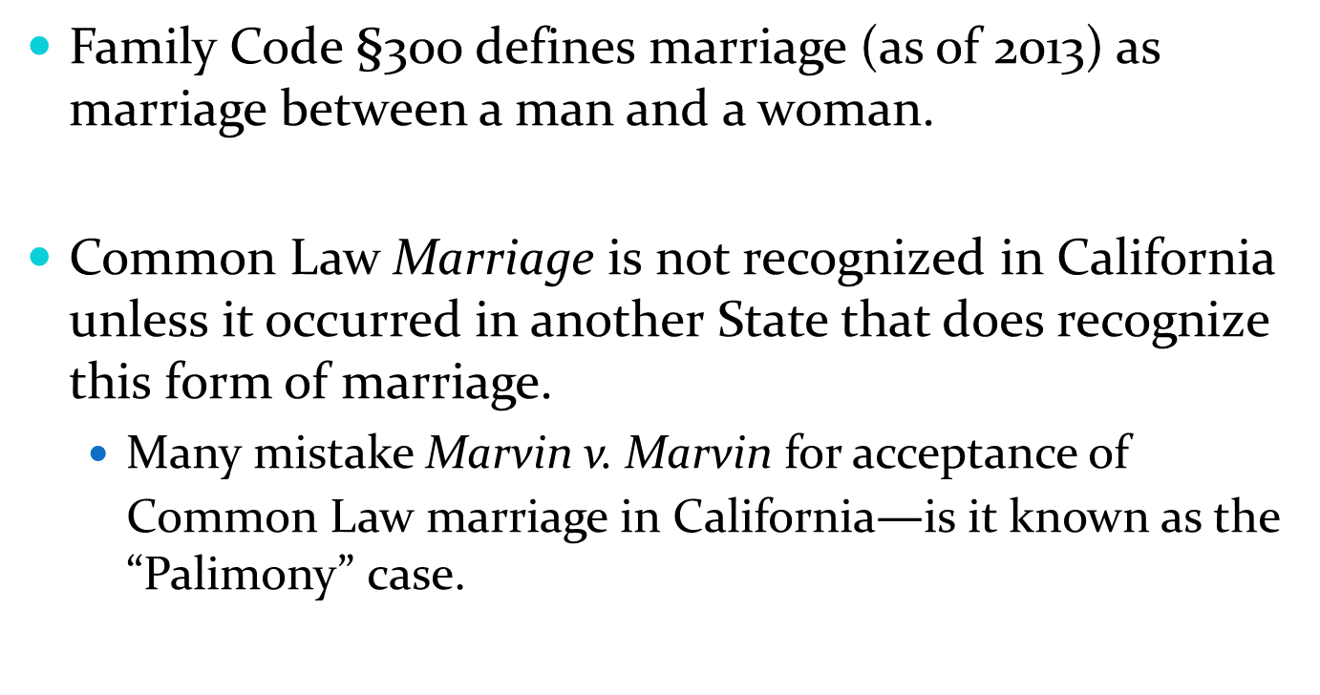
What is a Marriage
Family Code §300 defines marriage (as of 2013) as marriage between a man and a woman.
Common Law Marriage is not recognized in California unless it occurred in another State that does recognize this form of marriage.
Many mistake Marvin v. Marvin for acceptance of Common Law marriage in California$—$is it known as the “Palimony” case.

Slide 7
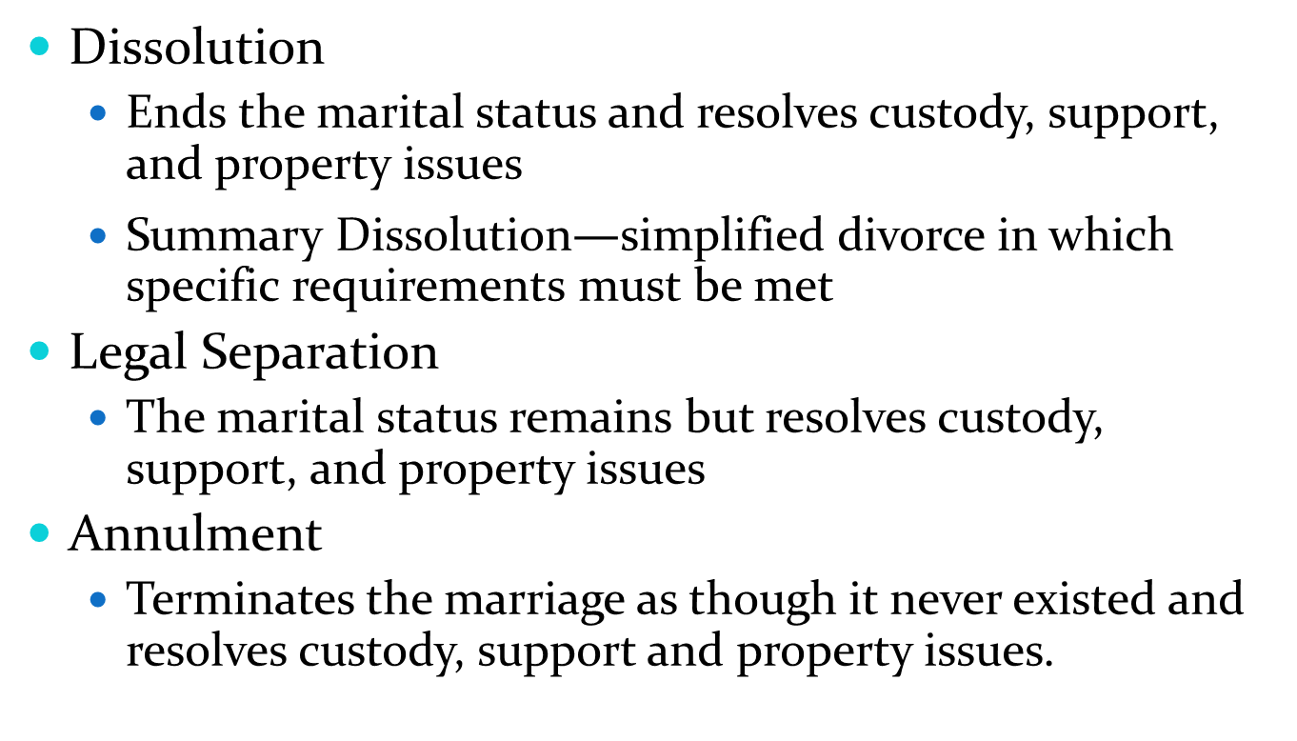
Methods of Dissolving a Marriage
Dissolution
Ends the marital status and resolves custody, support, and property issues
Summary Dissolution$—$simplified divorce in which specific requirements must be met
Legal Separation
The marital status remains but resolves custody, support, and property issues
Annulment
Terminates the marriage as though it never existed and resolves custody, support and property issues.

Slide 8
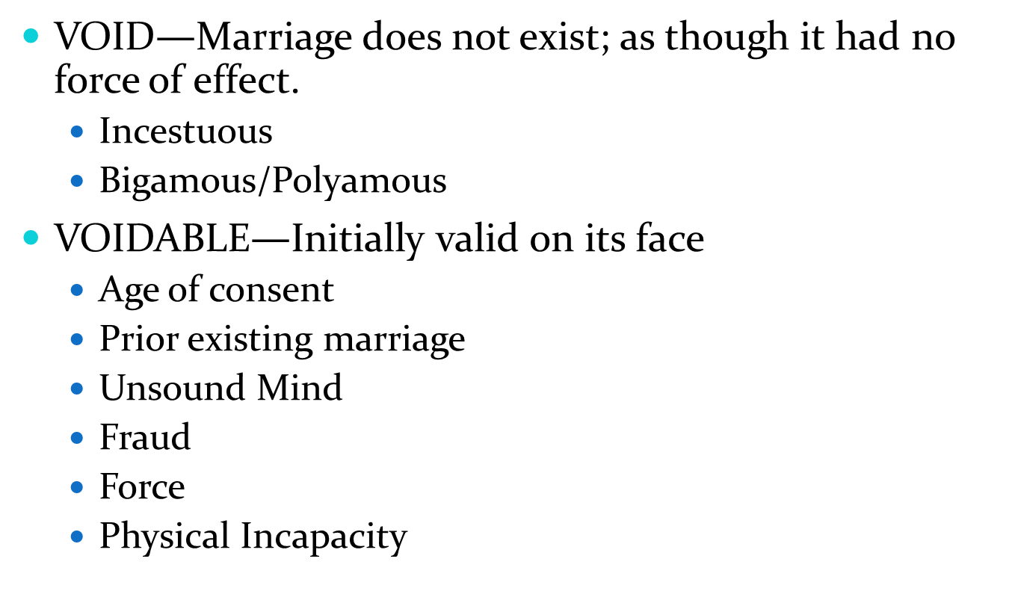
Void and Voidable Marriage
VOID$—$Marriage does not exist; as though it had no force of effect.
Incestuous
Bigamous/Polyamous
VOIDABLE$—$Initially valid on its face
Age of consent
Prior existing marriage
Unsound Mind
Fraud
Force
Physical Incapacity

Slide 9
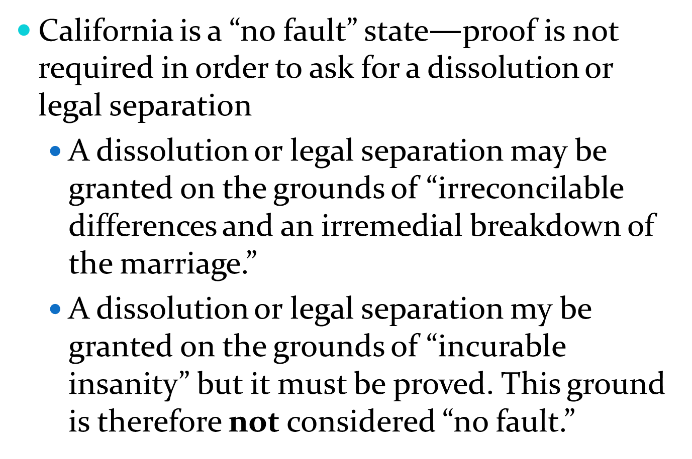
California—A no fault state
California is a “no fault” state$—$proof is not required in order to ask for a dissolution or legal separation
A dissolution or legal separation may be granted on the grounds of “irreconcilable differences and an irremedial breakdown of the marriage.”
A dissolution or legal separation my be granted on the grounds of “incurable insanity” but it must be proved. This ground is therefore not considered “no fault.”

Slide 10
The full set of PowerPoint slides is available upon adoption. Email bhall@cap-press.com for more information.

