Slide 1
Why American Prisons Fail: How to Fix Them without Spending More Money (Maybe Less) Peyton Paxson and George H. Watson

Slide 2
Chapter 1 Mass Incarceration
Why American Prisons Fail

Slide 3
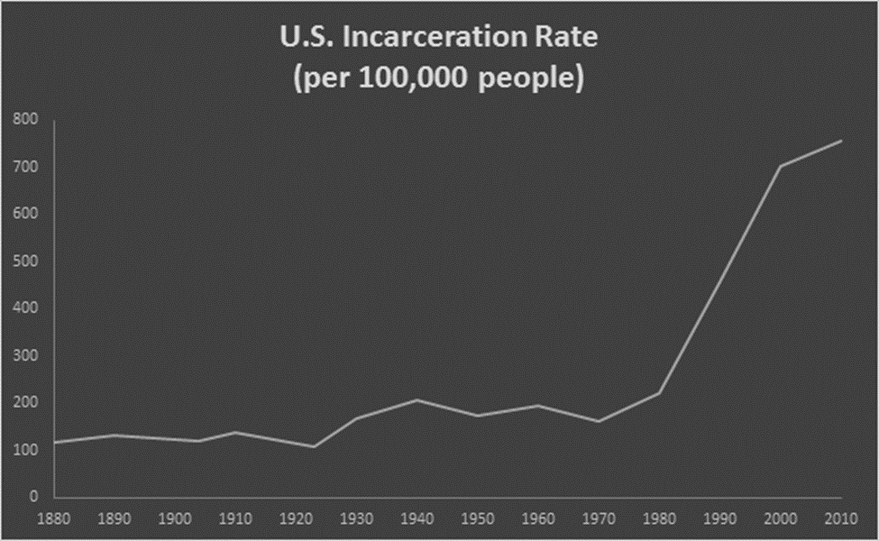
Mass Incarceration Began in the U.S. in the 1970s

Slide 4
Causes of Mass Incarceration
Highly politicized criminal justice system
Baby Boom—large group of young people, who are the most likely to commit crimes
“Nothing works”—Federal Bureau of Prisons and many states gave up on rehabilitation
War on Drugs—Nixon and Reagan administrations focused on drug dealers and drug users
Mandatory minimums—politically popular effort by legislatures to take away sentencing discretion from judges and juries
“Get Tough” movement—longer sentences, less prison programming

Slide 5
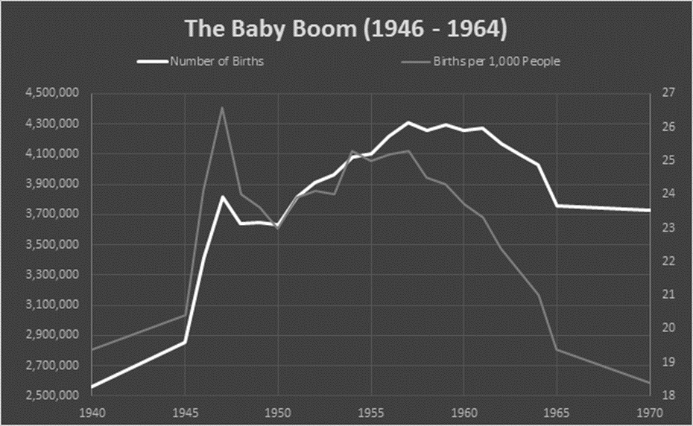
The Baby Boom Contributed to the Rise in Crime in the 1960s and 1970s

Slide 6
Violent Crimes Peaked in the Early 1990s

Slide 7
Violent Crimes Peaked in the Early 1990s

Slide 8
Violent Crimes Increased Dramatically in the 1960s

Slide 9
Property Crimes also Increased Dramatically in the 1960s

Slide 10
Drug Arrests Increased in Most Years from 1981

Slide 11
The full set of PowerPoint slides is available upon adoption. Email bhall@cap-press.com for more information.

