Slide 1
Community Property in the United States Eighth Edition
Chapter One

Slide 2
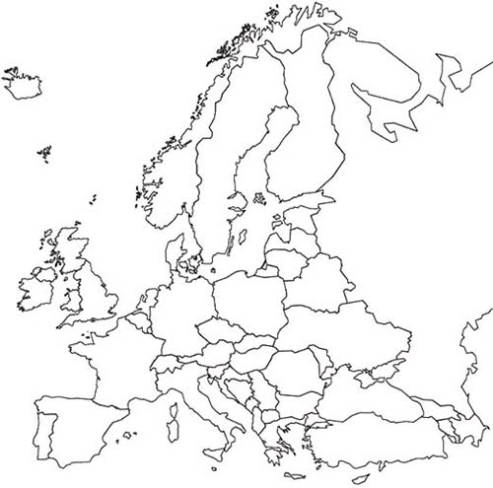
Empire of the Huns
Roman Empire

Slide 3
Roman Empire

Slide 6
Fuero Juzgo
That this provision as to community property represents a purely Visigothic custom, uninfluenced by Roman law, is readily apparent from the existence of the community which is shown in the Visigothic code in Sweden, the existence of the custom among the other Germanic tribes, and its entire absence from the Roman law.

Slide 7
History of Codification of Community Property in Spain
Mid-600s
712
1254
1566
1567
1805
Siete Partidas
Moorish
Rule
Fuero Juzgo
Fuero Real
Leyes de Estilo
Novisima Recopilacion
Nueva Recopilacion

Slide 9
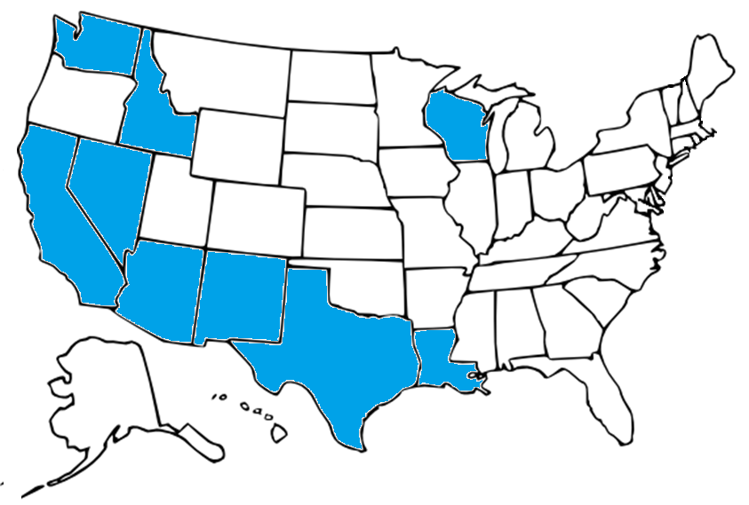
Community Property Jurisdictions in the United States

Slide 10
The full set of PowerPoint slides is available upon adoption. Email crutan@cap-press.com for more information.

