Slide 1
A STUDENT ELECTRONIC DISCOVERY PRIMER
AN ESSENTIAL COMPANION FOR CIVIL PROCEDURE COURSES
WILLIAM F. HAMILTON JENNIFER M. SMITH
hamiltonw@law.ufl.edu jennifer.smith@famu.edu

Slide 2
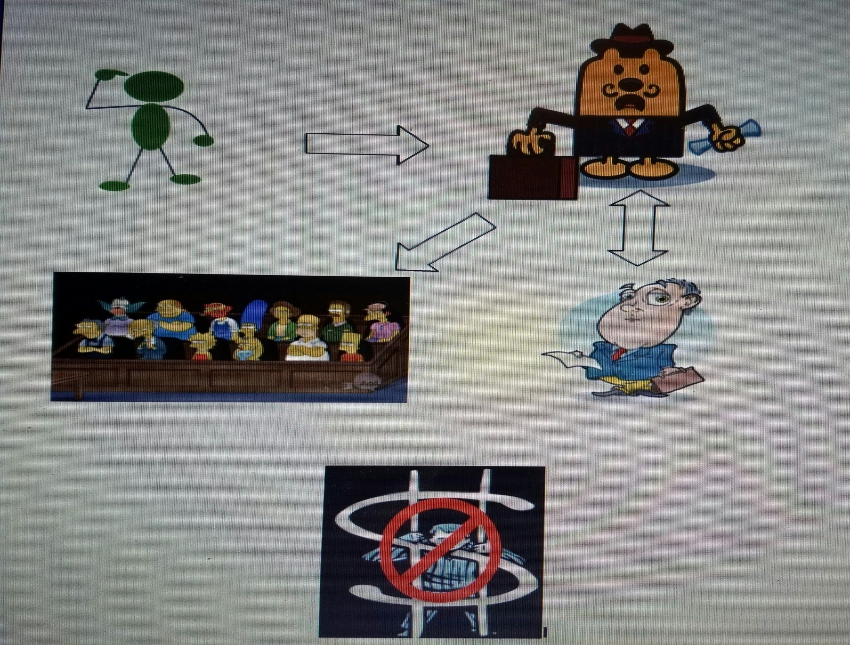
What is [Electronic] Discovery?

Slide 3
Social and Legal Forces
Driving Digitization
Nearly all personal and business activities are done using computers
Government activities also are computerized, pursuant to laws at federal and state level
Emails have exceeded telephone and postal communications
Millions of transactions with legal relevance are occurring using computers
“Social Media,” embraced by world culture is now used by business

Slide 4
“There can be no real justice without truth, and in today’s world of civil litigation, no real truth without e-discovery. That is because writings are the key evidence in most cases and almost all writings today are electronic.”
    -Ralph Losey, August 21, 2010
    http://e-discoveryteam.com/interviews/ethics-interview/

Slide 5
What are “electronic documents”?
Information created, stored, and/or utilized using computer technology
Office productivity documents such as word processing files and databases
Internet e-mail and web traffic
Information on peripheral and mobile devices
Computer-based record storage, such as disks, tapes, and drives

Slide 6
What Makes ESI Different from Paper?
E-documents are easy to create, edit, and circulate
E-mails have replaced telephone and water-cooler conversations
E-documents are inexpensive to store
E-documents are fragile but hard to completely delete/destroy

Slide 7
ESI Volume
Hypothetical email system
  100 employees
  25 messages/employee/day
  250 full working days/year
625,000 messages/per year

Slide 8
ESI Locations
Email servers
Laptop computers
Home computers
Palm Pilots
Hard drives
Other hard drives and email servers in organization (including jump drives)
Outside recipients (hard drives, servers, backups)
Servers
Backup media
Digital phone records, car systems, smart cards, etc.…

