Slide 1
Introduction to Debtors’ & Creditors’ Rights; Judicial Collection – Introduction, Execution © Charles Tabb 2016

Slide 2
Our topic
Money – or more accurately, the lack thereof
And what happens then in the world of debtors and creditors

Slide 3
Creditor worries?
What do CREDITORS have to worry about?
How will they get paid the money they are owed??

Slide 4
1st issue: Creditor vs Debtor
How can this Creditor
collect from this Debtor?

Slide 5
A 2-party issue only
Like an arm-wrestling match: Cr v Dr
No one else involved

Slide 6
Problems?
No money – cupboards are bare
If the Debtor is broke,
they’re broke, and you
aren’t going to collect
You can’t eat a decent meal out of this cupboard

Slide 7
Sneaky debtor
Or the debtor might have money, but they won’t give it up without a fight

Slide 8
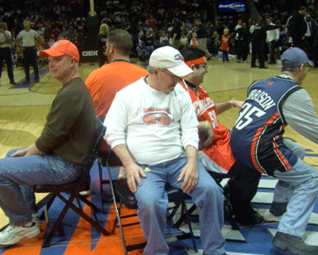
2nd issue: Priority fights
Not just Cr v Dr
Creditor has to compete with other claimants for Debtor’s insufficient assets – other creditors, purchasers
Someone may get
left out!

Slide 9
What do Debtors worry about?
Do they have enough money to
pay their debts?
Will they have any $ left?

Slide 10
Debtor worries
Will they be able to get credit in the future?

Slide 11
The full set of PowerPoint slides is available upon adoption. Email bhall@cap-press.com for more information.

