Slide 1
Introduction to Sport Management

Slide 2
The Changing Role
Sport Management has changed over the years.
The Old Days: Football Coach was the Athletic Director.
The Athletic Director was an old coach
Nice move
Put out to pasture
Shake hands

Slide 3
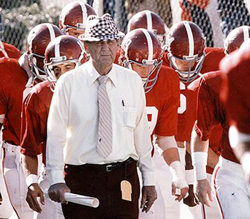

Slide 4
University of North Carolina
1970
Separated the position
Most Colleges have followed
Many High Schools will not let a coach be the A.D.
It is a full-time job now
The Holy Trinity is gone

Slide 5
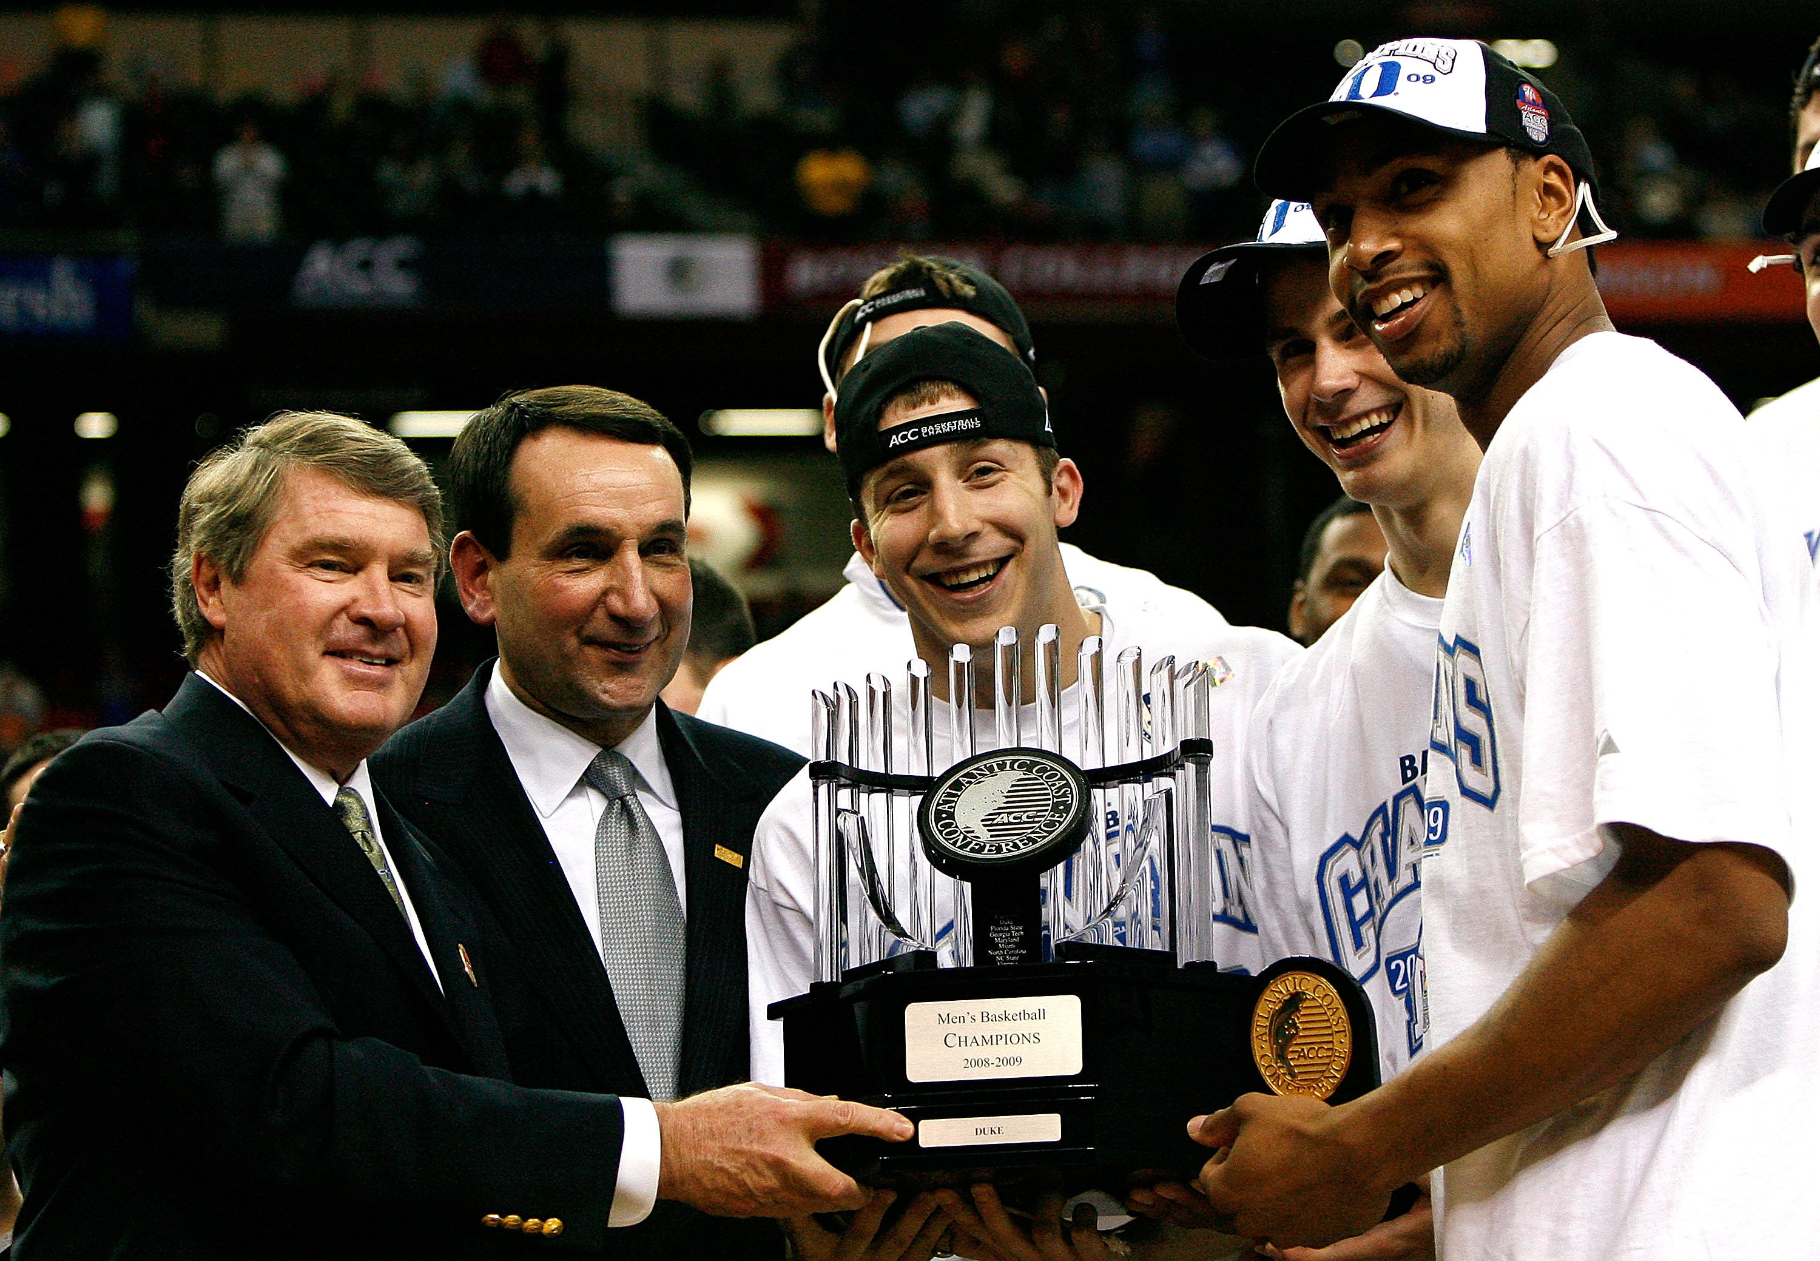

Slide 6
John Swofford
UNC
Football
Grad School
Ohio University
Masters in Athletic Administration
First Program
Late 1960s

Slide 7
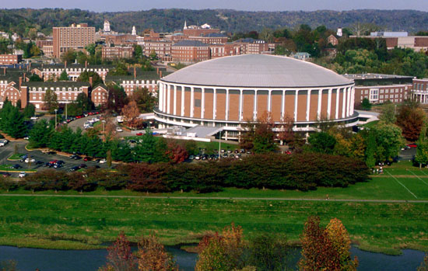

Slide 8
UMASS
1970s, Second Grad program
Emphasis on Pro Sport
Business and Sport
Money issues
Fundraising
Don Canham
University of Michigan

Slide 9


Slide 10
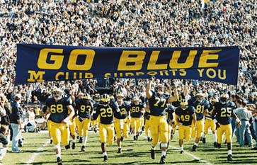

Slide 11
Undergrad Programs
Guilford College
First in North Carolina
Prepare undergrads for jobs in the sport industry
Opportunities for people who want to stay connected
It is still business

Slide 12
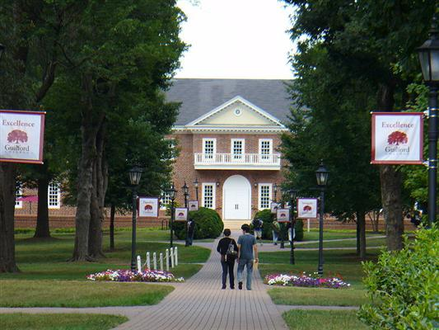

Slide 13
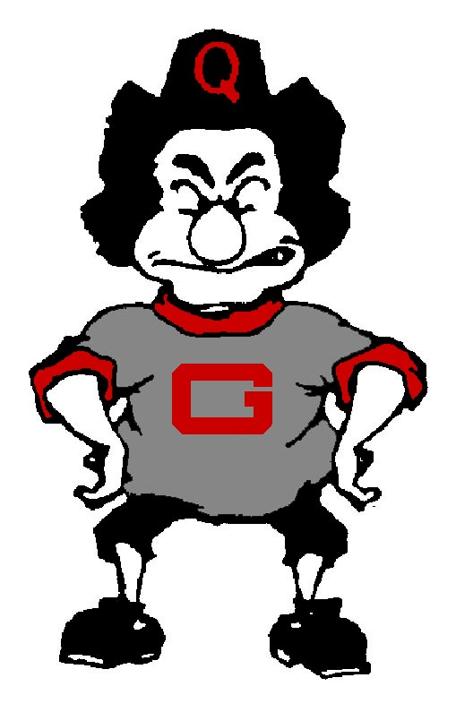

Slide 14
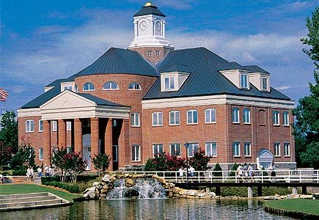
Wingate University

Slide 15
Nationally Approved
2002
36 undergraduate programs
Accreditation

Slide 16
The full set of PowerPoint slides is available upon adoption.
Email bhall@cap-press.com
for more information.

