Slide 1
GENDER ISSUES AND INTERNATIONAL LAW
Overview of the Course:
Text: International Women’s Rights, Equality, and Justice
Research paper & oral presentation (10 minutes)
At least one required meeting with me to get paper topic approved
Once topic is approved, must email me research outline

Slide 2
How class works
You read relevant chapter before class
In class—I provide more information on topic through slides
Often short documentary clip
Class discussion fostered by groups of students (assigned)
Slides will be posted on TWEN

Slide 3
Overview/Outline of this Class
Provide general overview of the development of Int’l Law & Human Rights Law in the UN system
Talk about specific treaties and conventions that deal with women’s rights
Talk about Convention on the Elimination of All Forms of Discrimination Against Women (CEDAW)

Slide 4
Terminology
International Law—deals with relationships between states
International Human Rights Law—deals with relationship between individuals, organizations and states regarding human rights guaranteed at state, regional and international level
Humanitarian Law—deals with law of armed conflict, war crimes, etc.

Slide 5
Early reference to women’s rights in International Law: 1904 International Agree-ment for Suppression of White Slave Traffic
Purpose was to protect women and girls from being forced or enticed into “immoral purposes” in order to “gratify the passions of another person” “in different countries”
Amended in 1910 to clarify that did not apply to domestic prostitution (governed by internal legislation)

Slide 6
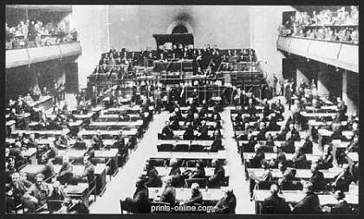
Later developments in trafficking
League of Nations studied trafficking—revised definition of slave trade to cover all races and male and female children
1921 International Convention for the Suppression of the Traffic in Women and Children

Slide 7
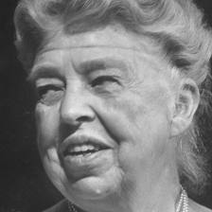
Evolution of Human Rights Law
1945 UN established (post WWII)
UN established a Commission on Human Rights and charged it with the task of drafting a document spelling out the meaning of the fundamental rights and freedoms proclaimed in the UN Charter.
Led to 1948 Universal Declaration of Human Rights

Slide 8
Where do Women’s Rights fit in?
First general focus on human rights—Art 1 of the Universal Declaration provides that all human beings are equal in dignity
Art 2—(women’s rights)—no distinction on the basis of sex)
Followed by the Covenant on Civil and Political Rights (ICCPR) (Art 2(1), Art 3 pertain to women)
Covenant on Economic, Social and Cultural Rights (IESCR)

Slide 9
1948 U.N. Declaration of Human Rights
Article 2.
Everyone is entitled to all the rights and freedoms set forth in this Declaration, without distinction of any kind, such as race, colour, sex, language, religion, political or other opinion, national or social origin, property, birth or other status.
Article 3.
Everyone has the right to life, liberty and security of person.

Slide 10
U.N. Decl. cont’d.
Article 4.
No one shall be held in slavery or servitude; slavery and the slave trade shall be prohibited in all their forms.
Article 5.
No one shall be subjected to torture or to cruel, inhuman or degrading treatment or punishment.
Article 6.
Everyone has the right to recognition everywhere as a person before the law.

Slide 11
The full set of PowerPoint slides is available upon adoption. Email crutan@cap-press.com for more information.

