Slide 1
Incident Management System
For Law Enforcement

Slide 2
What Is IMS?
Management System for any incident
Based on five functions
One added for Law Enforcement—Intelligence
Notes:
The goal of this presentation is to facilitate participants to understand and use functions of the Incident Management System (IMS), known formerly as the Incident Command System (ICS), including its:
Rationale for using IMS
Framework
How to use IMS
Describe local examples of events which demonstrate success or failure of IMS.
Highlight the need for coordination and cooperation among responders.
Discussion Question: Consider exploring local events which required or needed IMS.
Examples of incidents include:
Large MVCs with multiple agencies such as fire, EMS, police, public works, and DOT
Industrial events which might require private responders to contain a hazmat leak, fire, EMS, police for evacuation and crowd control, public works to prevent runoff
Downed power lines which require police, possibly fire, and utility company
IMS allows multiple agencies to work together in a coordinated manner.
Discussion Question: Who is in charge? Remember this should be established by MOU prior to events and usually the agency with legal authority is in charge. However, crimes may require police to work with fire and EMS cooperatively as do MVCs even though the police are in charge.

Slide 3
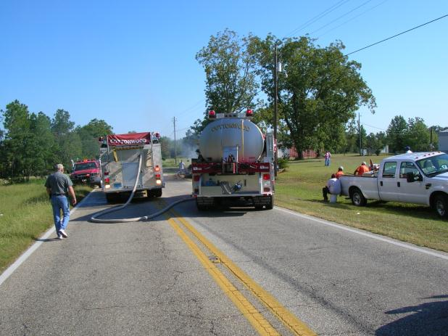
Why Use IMS?
Responder Safety
Establish Strategy
Effective Use of Resources
Tactical Coordination
Establish Roles and
Responsibilities
Applicable across jurisdictions and agency function
IMS/NIMS is both flexible and expandable
IMS/NIMS represents a “best practice”
Notes:
Fire, police, and DOT work a vehicle fire involving a truck load of hay
Must have MOU in place prior to the event.
Discussion Question: Why is a MOU needed?
IMS is a standard system
Provides consistent methods to communicate, plan, and work
Provides an efficient framework in many incidents (remember some law enforcement events may not work well within IMS)
Makes those working the incident to think in a formal manner (however, this may impair flexibility and cause group think)
Roles are formalized (however, remember the system is designed for fire and may not fit law enforcement operations without modification)
Uses an approach with multiple stake holders and those involved within the event
Provides a framework for communications (remember the use of plain language is discouraged when agencies involved use a common code system, plain language consumes radio air time)
Command structure should be established prior to the event
Discussion Question: To what extent does your area use IMS?
The system should be practiced prior to the event
Use management by objectives
Develop an incident action plan on long lived events
Use resources efficiently
Coordinate actions by every agency involved
Provides for a variety of roles and responsibilities

Slide 4
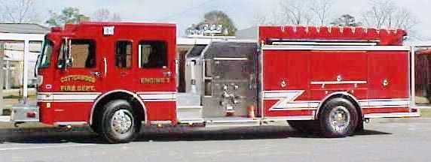
Problems with IMS for Law Enforcement
Fire Service Philosophy
Rigid Structure
Central Control
Narrow span of control
No autonomy of
personnel
No independent actions
Ask before you act
Personnel tend to “specialists”
Notes:
Issues with IMS for Law Enforcement
IMS provides a rigid structure while law enforcement needs a flexible structure
IMS uses central control while law enforcement needs disseminated control and autonomy and independent decision making
IMS uses narrow spans of control while law enforcement may have very large spans of control (20-30 reporting to one supervisor)
IMS uses ask before you act while law enforcement is act first then report
Police officers tend to be generalists while fire personnel tend to be specialists
Discussion Question: How do fire and EMS missions differ from law enforcement? How do they conflict?

Slide 5
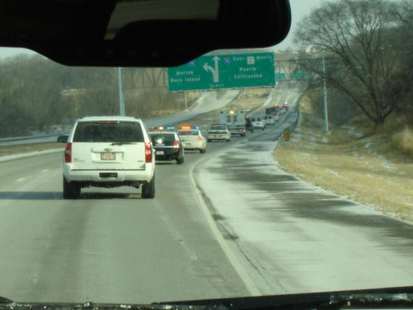
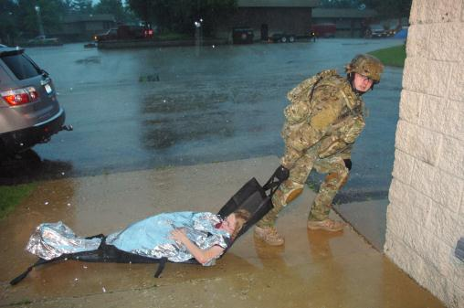
Law Enforcement
Large spans of control
Do not need a rigid framework
Encourage autonomy
Encourage independent action
Central control is “after the fact”
Remember IMS is a “guide”
Photos by Dr. John Wipfler
Notes:
Simulated rescue of a injured person in a tactical situation, a high-profile prisoner movement with convoy.
Law enforcement has a broad array of incidents which do not fit into a standard template
Law enforcement needs flexibility and encourages independent action by officers
Law enforcement has many legal constraints
Law enforcement acts then reports
IMS is a “guide,” not an inflexible requirement
Discussion Question: Can you cite some problems with IMS you have experienced or anticipate?

Slide 6
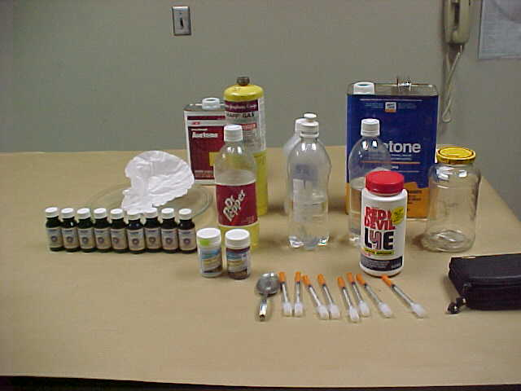
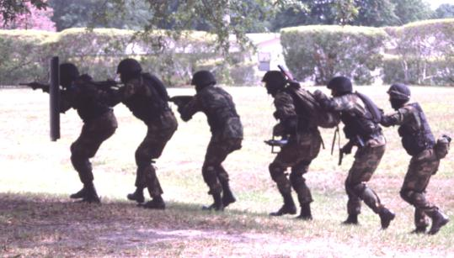
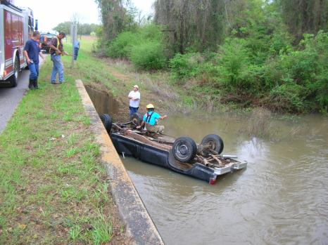
When is IMS Used?
During every incident, tactical events, clan labs, MVCs, others
Notes:
Red phosphorus clandestine drug laboratory for making methamphetamine, tactical movement in a callout, fatal vehicle crash with fire, EMS, and police on scene.
IMS should be used at every event
Practice makes its use a habit
Discussion Question: Is IMS practical on most calls for service? In most cases IMS is not used on simple calls or even calls with several units. Law enforcement does this routinely and does it well. However, with special events, intense events, large scale events, long lived events, or during disasters, IMS should be used.

Slide 7
Incident Management System
Added for law enforcement
Incident
Commander
Command
Intelligence
Safety
Command Staff
Public Information
Liaison
Finance/
Administration
Logistics
Operations
Planning
General Staff
Notes:
Command
This is the person acting as the incident commander, he or she may be the first office on the scene, a supervisor, or chief
This may change several times
Usually the ranking person
Needs a staff to support the command structure including Intelligence, Safety, PI, and Liaison
Other general staff functions which may need to be filled include (some may be combined or not used):
Finance – Administration (if the event is large or prolonged)
Logistics (if the event is large or prolonged)
Operations (at every event)
Planning (may be needed if the event is large or prolonged)
In many instances roles may be combined.
Intelligence gathers information about the suspects, victims, locale, and may use local, state, federal, and private databases, may be obtained from interviews, building plans, medical information, maps, GIS, and other sources.
Discussion Question: Why is gathering intelligence so critical in long-lived or intense events?

Slide 8
Law Enforcement
Unified Command
Safety Officer
Liaison Officer
JIC/JIS/PIO
Intelligence
Finance
Logistics
Operations
Planning
Staging
Support
Branch
Service
Branch
Resources
Unit
Time
Unit
Fire
Branch
Law
Enforcement
Branch
Supply
Unit
Comm
Unit
Procurement
Unit
Situations
Unit
Facilities
Unit
Medical
Unit
EMS
Fire/
HazMat
Evacuation
Compensation/
Claims Unit
Documentation
Unit
Ground
Support
Unit
Food
Unit
CCP
Search
Investigation
Cost
Unit
Demobilization
Unit
Rescue
Triage
Treatment
Perimeter
Entry
Technical
Specialists
Transport
Traffic
Public
Health
Decon
Morgue
Hospitals
Access
Rail
Refuge
Notes:
Note the place of LE in a large incident involving multiple agencies.
Remember the command will include other agencies; several sub-sections may be part of police operations, such as evacuation, investigation, traffic, or perimeter.

Slide 9
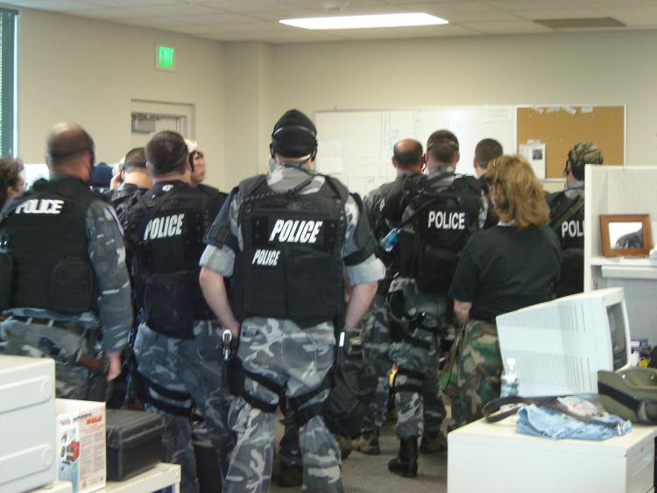
Incident Management System
IMS is a management system that applies common business practices to incident response
Planning
Directing
Organizing
Coordinating
Communicating
Delegating
Evaluating
Photo by Dr. John Wipfler
Notes:
Officers are briefed prior to a tactical deployment.
IMS uses common business practices (law enforcement does this routinely, we call it different things such as SOPs, general orders, procedural orders)
IMS uses management by objectives (this is instinctive to law enforcement, police know that object is to protect life and property)
IMS uses an incident action plan to establish the objectives (in sustained events, law enforcement does this but does not usually follow the IMS criteria)
IMS uses delegation of authority and power (already understood in law enforcement operations as they are paramilitary operations)
Discussion Question: Will IMS cause officers to more efficiently perform these tasks?

Slide 10
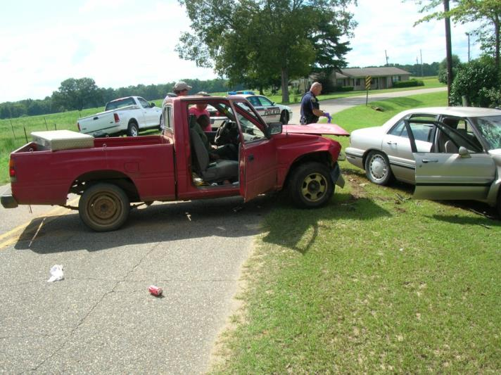
Effective Incident Management
Requires:
Establishing objectives
Setting priorities
Assigning resources
Coordination of
several agencies with
differing missions
Notes:
MVC with two persons injured critically, fire, police, and EMS are on scene.
Incidents require efforts to protect life, protect property, protect the environment, and allow recovery
This requires one to establishing objectives, determine priorities, and use resources efficiently with rescue of the victims, control of traffic, investigation of the crash, and removal of the vehicles
Coordination between police, fire, EMS, and a wrecker company are required
Police serve as the incident commander using a unified command with fire and EMS
Discussion Question: Where can conflict arise with the differing missions?

Slide 11
The full set of PowerPoint slides is available upon adoption. Email bhall@cap-press.com for more information.

