Slide 1
Decentralized State of U.S. Law Enforcement
12,200+ municipal police departments
3,000+ county sheriff’s departments
50 state police/state patrol organizations
1,700 special jurisdiction police departments
Campus police, park police, airport police…
1 million persons employed by state/local agencies
701,000 are sworn officers
Approx. 137,000 sworn personnel at the federal level
Copyright © 2023 Carolina Academic Press. All rights reserved.

Slide 2
Criticisms of Decentralized Law Enforcement
1) Uneven and/or unequal quality of police service
2) Inability to set national law enforcement policy
3) Disjointed response to crime overlapping jurisdictions
4) Competition and sub-cultural differences between agencies can result in an intentional lack of cooperation
Copyright © 2023 Carolina Academic Press. All rights reserved.

Slide 3
Advantages of Decentralized Law Enforcement
1) Power is dispersed
And shared by national and state sovereigns
State filters down to municipal, county, & special jurisdictions
Abuses of power are more easily identifiable and confined to a given area
2) Police activity is more manageable and efficient
At the local levels, it is easier manage activity and to make direct decisions on policing tactics and strategy
Copyright © 2023 Carolina Academic Press. All rights reserved.

Slide 4
Advantages of Decentralized Law Enforcement (Cont’d)
3) Police leaders can be more easily held accountable by local officials and their affected public
Unlike lower levels of influence of regular citizens’ criticisms of state and federal officials
4) Permits the opportunity to observe, chronicle, & study multiple strategies and tactics for policing
Thousands of analyses by government jurisdictions = thousands of studies and results leading towards better policing practices
Copyright © 2023 Carolina Academic Press. All rights reserved.

Slide 5
Advantages of Decentralized Law Enforcement (Cont’d)
Decentralization causes a primary focus on deterring crime at the local level
However, approx. 14% of gun-carrying, arrest-making law officers in a country are from the federal level
Copyright © 2023 Carolina Academic Press. All rights reserved.

Slide 6
Federal Law Enforcement by the Numbers
The primary responsible federal department is the U.S. Department of Justice (DOJ)
Employs: criminal investigators, prosecutors, civil attorneys, crime and intelligence analysts, correctional officers, victims advocates, & any others pursing DOJ’s mission
DOJ’s budget for Fiscal Year 2021 $33.4 billion
FY 2022 budget request was $35.3 billion
Includes funding for 117,954 personnel positions
Law enforcement (47%), prisons & detention (27%), litigation (10%), grants (13%), administrative/other (3%)
Copyright © 2023 Carolina Academic Press. All rights reserved.

Slide 7
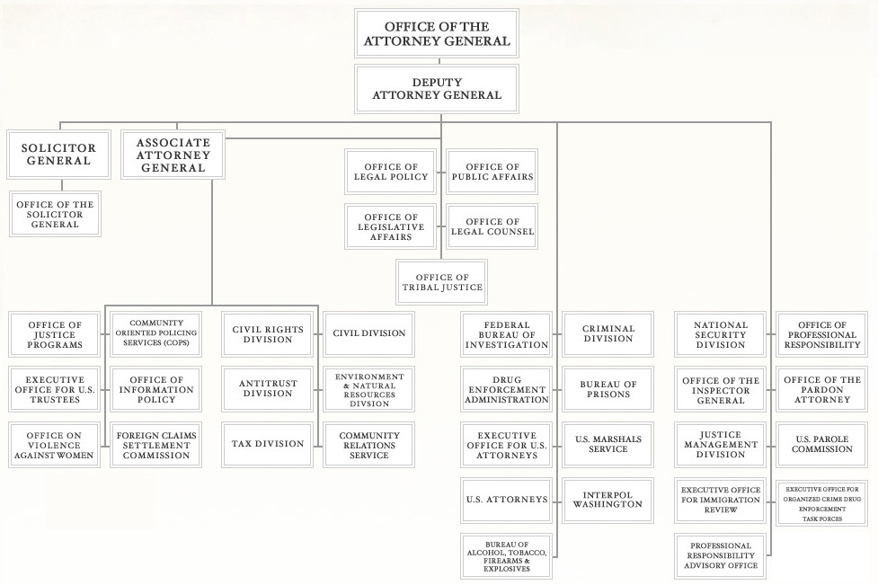
U.S. Department of Justice Organization Chart (pg. 19)
Copyright © 2023 Carolina Academic Press. All rights reserved.
U.S. Department of Justice, http://www.justice.gov/agencies/images/orgchart.pdf

Slide 8
Federal Law Enforcement Census Data
Sept 2022 report of DOJ’s Bureau of Justice Statistics (BJS) census of federal law enforcement officers
Results from available 2020 data
Approx. 137,000 full-time federal law enforcement officers
93,000 (68%) primarily performed criminal investigative duties
11,800 (9%) focused on police response and patrol
Copyright © 2023 Carolina Academic Press. All rights reserved.

Slide 9
BJS Census (Cont’d)
Federal Bureau of Investigation (FBI)
13,575 special agents
Drug Enforcement Agency (DEA)
4,380 special agents
Bureau of Alcohol, Tobacco, Firearms and Explosives (ATF)
2,653 special agents
Copyright © 2023 Carolina Academic Press. All rights reserved.

Slide 10
Department of Homeland Security (DHS)
From BJS statistics in 2008:
U.S. Customs and Border Protection (CBP)
47,000 law enforcement officers
Bureau of Immigration and Customs Enforcement (ICE)
Approx 13,000 special agents and enforcement removal officers
U.S. Secret Service (USSS)
Approx. 3,000 special agents
Copyright © 2023 Carolina Academic Press. All rights reserved.

Slide 11
Minorities and Women in Federal Law Enforcement
Greater percentages than at local levels, on average
In 2020:
14.5% law enforcement officers were women
39% of federal law enforcement officers considered him/herself part of a racial minority group
As compared to 28.5% of local law enforcement officers
Copyright © 2023 Carolina Academic Press. All rights reserved.

Slide 12
The full set of 441 slides is available upon adoption. Please contact Beth Hall at bhall@cap-press.com to request your slides.

